Slide 1

ChartFlo
Team 4.13
May 16, 2021

Slide 2

5rns = 12 hrs= 30patients=25 min per pt=750 min per shift=1500 min in 24hr = 25 hr saved in 24hr.
Overtime 1hr= 10 rns=24 hr=10 hours X $50per hour=$500.00
Per day X 365= $182,500 saving for 10 nurses = 40 rn per unit=$7,300,000.00,
10 units hospital= $73,000,000.00

Slide 3
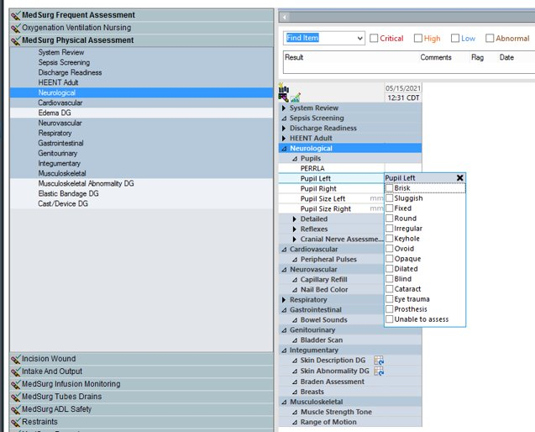

Team 4.13

Slide 4



Currently Available Solutions
Team 4.13
Companies utilize speech recognition to enter medical records, but no one is yet using cognitive computing for transforming data into useful structured data.
Our goal is efficient and accurate documentation.

Slide 5
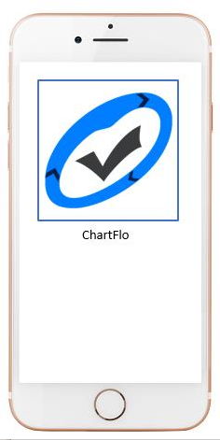
ChartFlo
Team 4.13
Cognitive computing solution
The nurse speaks assessment into app
Voice is transformed into structured data
Nurse needs to verify and sign the assessment

Slide 6
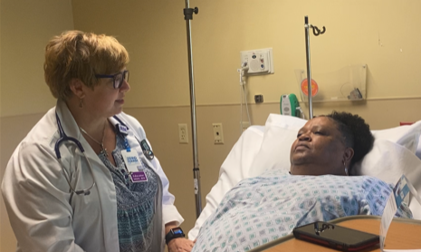
ChartFlo in Action
Team 4.13
Patients feel included in their care​
Improved patient satisfaction scores​
Increased reimbursement​
Increased satisfaction & nurse retention​
Nurse spends more time with patient​

Slide 7
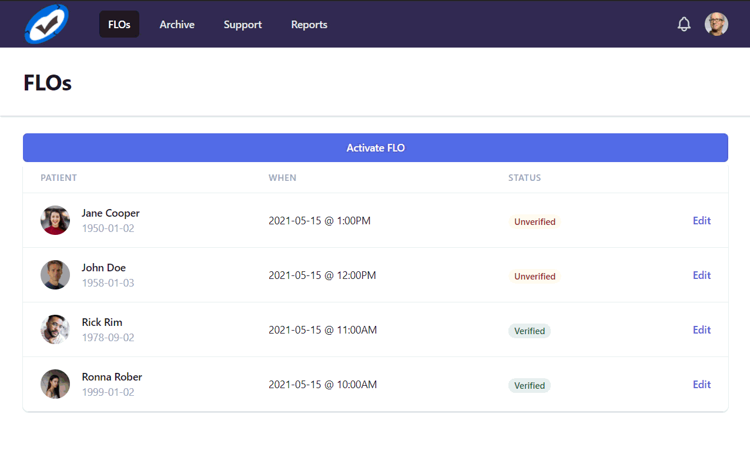
Team 4.13

Slide 8
Team 4.13
Does it Save Time?
TASK | Time to Perform (per patient) | Time to Document (per patient) | Time to Document with ChartFlo (per patient) | Time Savings (per patient)
Assessment | 15 minutes | 30 minutes | 5 minutes to verify | 25 minutes

Slide 9



Does it Save Money?
$300K
$73 million

Slide 10
Implementation Timeline
NurseHack2021
Research
MVP – Phase I
Voice2Text - 3 months - $100K
Trial run
Computer & mobile device - 3 months - $30K
MVP – Phase II
Structured data - 3 months - $100K
Trial run
Computer & mobile device - 3 months - $70K
Production
6 months - $200K
Device trial run
Smart glasses, digital watches, etc - 3 months - $100K

Slide 11
ChartFlo
Team 4.13
Integrating the patient, the nurse, and the data.
More time for what really matters.

Slide 12
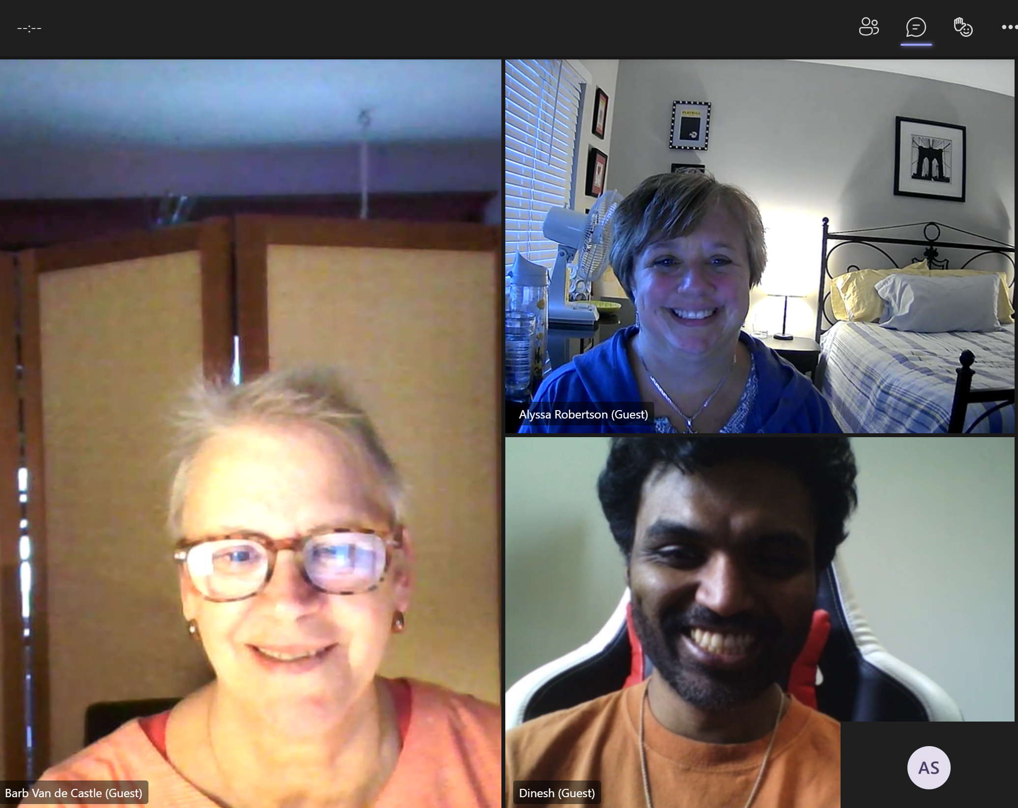
Team ChartFlo
Team 4.13
Team Leader
Alyssa Robertson alykat007@aol.com
Barb Van de Castle barbvan@gmail.com
Dinesh Antony dfa2222@gmail.com

